Slide 1
Suburbanization in the Brno region and its social consequences
24.5.2012, Brno
Antonín Vaishar, Jana Žitňáková

Slide 2
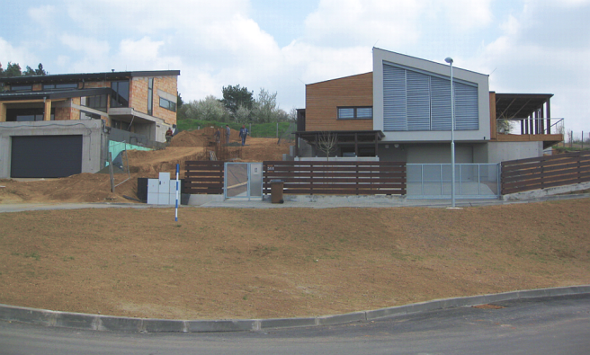
Suburbanization
Chapter 1
Transfer of inhabitants, their activities and some functions from the nuclear city to its fringe
Residential suburbanisation – origin of satellite townships
Commercial suburbanization – construction of logistic areas, hypermarkets etc.

Slide 3
Suburbanization under central planned economy
Central planned economy did not support suburbanization but concentration
Prefabricated housing estates
In the countryside: concentration of housing building to the central places (including houses with 4 – 6 apartments and other not suitable dwellings)
Cottages as some substitution of suburbanization

Slide 4
Suburbanization around Brno
Housing estates? Some problems are similar to satellite townships
Releasing after 1989
Suburbanization within the administrative territory of Brno
Suburbanization in the Brno surroundings has started in mass after 2000

Slide 5
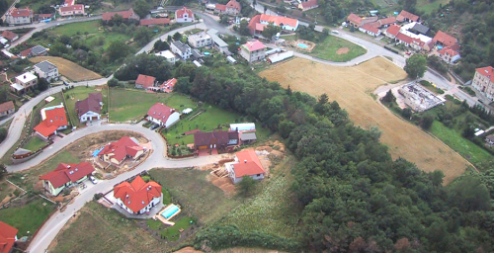
Population development 2001 - 2011
Source: Population censes 2001, 2011, Czech Statistical Office

Slide 6
Share of the people in the age 15+ with university education
Source: Population census 2011, Czech Statistical Office

Slide 7
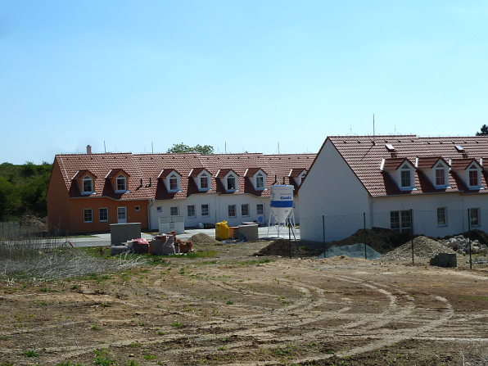
General evaluation
Population development
Education
Construction of new flats
Decrease of arable land
Increase of built-up area

Slide 8
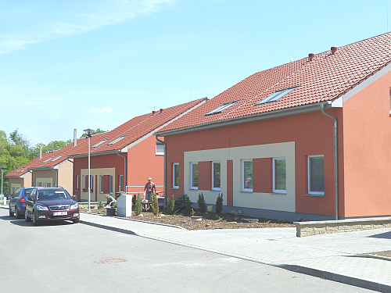
Suburbanization of Brno
The main area of suburbanization extends approximately to the distance of 15 km
Commercial suburbanization mainly in the south (crossroads of highways to Prague, Vienna, Bratislava and Ostrava)
Residential suburbanization selective according to availability of plots, receptiveness of local authorities, attractiveness of respective places etc.

Slide 9
Satellite townships
Insufficient financial sources – small plots, houses closely each to another, limited intimacy
If the township is separated from original village: isolation from public spaces, shops and other equipment resulting in bad relations between new and old settlers, sometimes higher dependence of the township on individual cars
Gated communities, blockage of the landscape, social separation

Slide 10
Architecture
Both houses and apartment buildings
Rich houses: tasteless buildings with many garnishes, in flagrant colors, high walls or opaque fences and ruthless to the surroundings
Common houses – uniform catalogue buildings without any thought
Commercial houses – gray blocks
Dominants are missing as a rule
The houses lost the rural character (no buildings for agriculture, no animals, loss of agricultural skills)

Slide 11
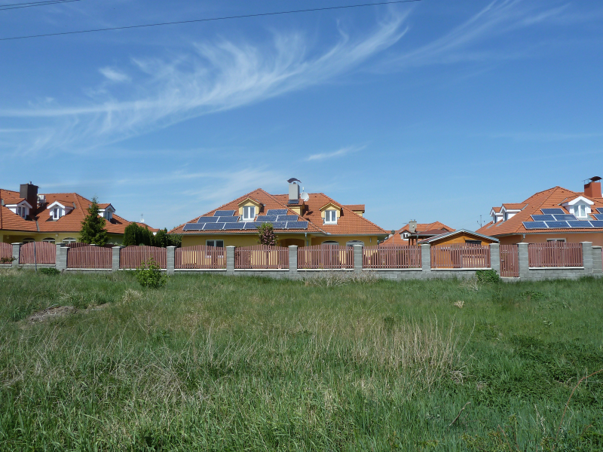
Typical suburb - Sokolnice

Slide 12
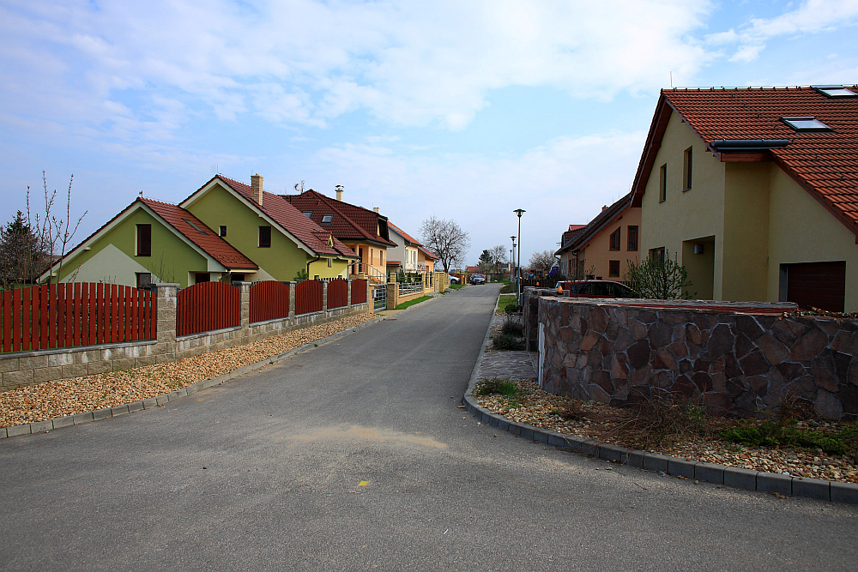
Suburbs lack sidewalks and any public spaces for communication among inhabitants: Podolí

Slide 13
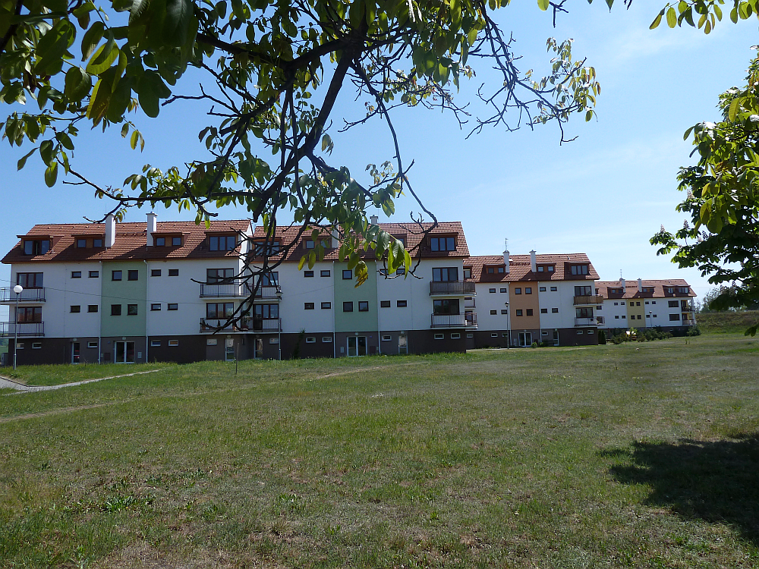
Suburbanization of apartment houses: Tvarožná

Slide 14
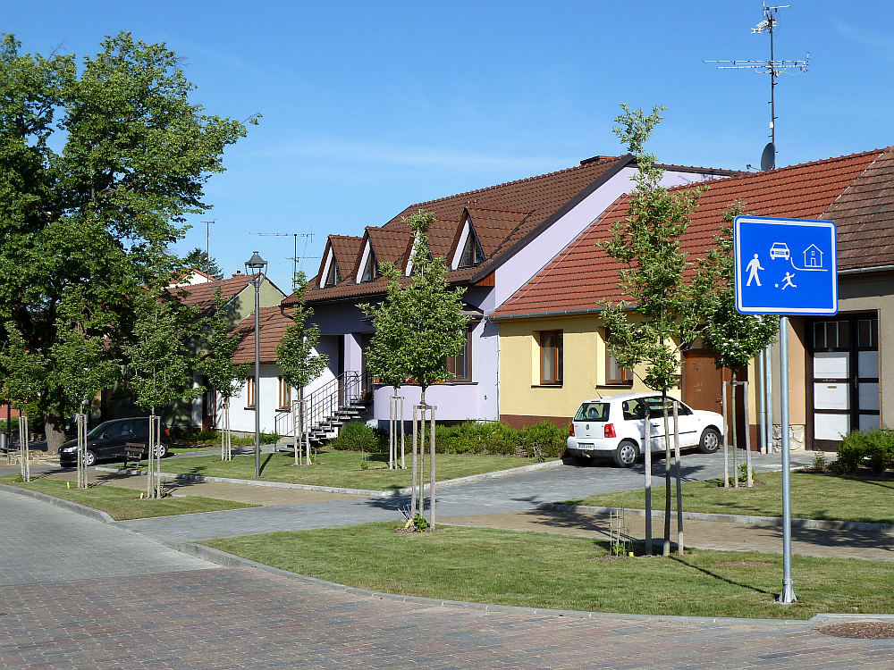
Suburbanization as reconstruction of elder houses: Sivice

Slide 15
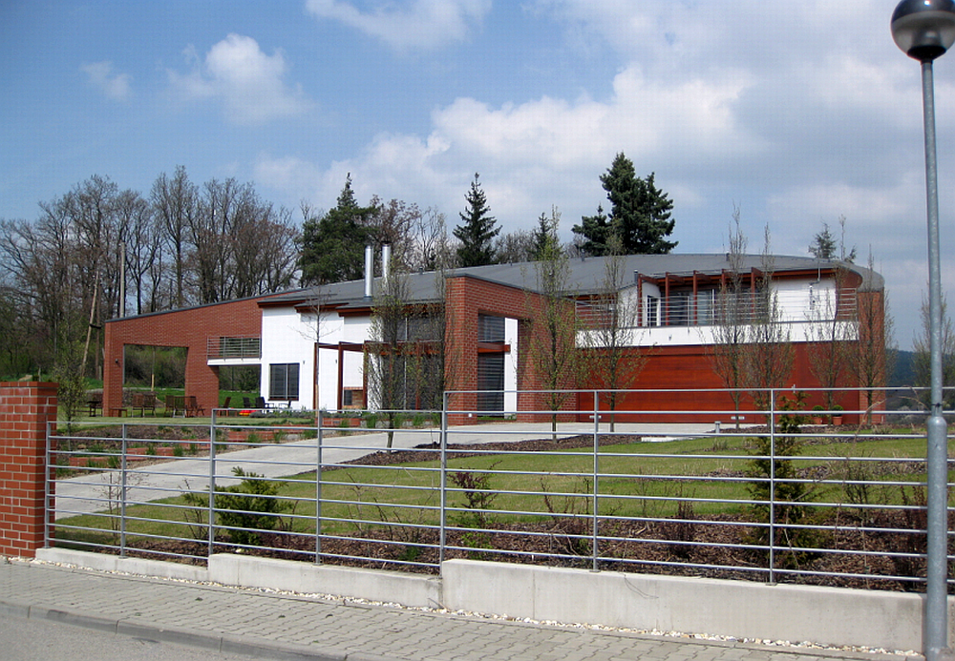
Rich houses occupy dominant positions: Lelekovice

Slide 16
Infrastructure
Suburbanization could lead to insufficient capability of technical networks like streets, supply of electricity, water, gas, sewage systems and wastewater treatment plants etc.;
The new settlers usually claim urban level of social services (starting with kindergartens) which is sometimes unrealistic
On the other side, the people use services usually in the place of their employment

Slide 17
Social consequences
One-sided social structure of incomers: young people, families with children or pairs, better educated, with higher social status
One-sided and short-term claims for services (e.g. Kindergartens or schools)
The social structure of new settlers usually improves the age, education, social structure of original village but it is positive only under condition of a good relations between old and new inhabitants

Slide 18
Daily program
Similar problems like in prefabricated estates: a majority of people leave the residences in the morning. The suburb is empty during the day (except of mother with little babies)
Inhabitants spend the time in the nuclear city: they work, shop, talk there; they only sleep in the suburb
Remaining people like housewifes („green widows“) or teenagers are cut away from the society

Slide 19
Unemployment December 2011
Czechia 8.8 %, South Moravian Region 9.8 %
Brno 9.2 %
Suburbanized small towns: Šlapanice 6.6 %, Modřice 7.8 %, Kuřim 7.9 %
District Brno-country: 7.6 %
The most suburbanized microregions: Židlochovice 6.8 %, Šlapanice 7.7 %, Kuřim 8.3 %
Conclusion: the unemployment in the suburbanized towns and villages is lower than in Brno itself

Slide 20
Transport
Transport enterprise of the City of Brno ensures frequent public transport 24 hours a day (villages which are administrative parts of the city, some small towns and other closer villages are connected)
Integrated transport system of South Moravian Region ensures frequent transport also for remaining villages (usually about 15 - 20 connections a day)
Nevertheless a car is frequently used like a symbol of independence and status of the people

Slide 21
Suburbanization and small towns
Small towns (or large villages) play an important role in the process. Kuřim, Šlapanice, Modřice can be named.
Advantages: they have basic urban services (schools, shops), their own job opportunities, better public transport (about 200 connections a day or more) → It is not necessary to visit the City in the case of any demand
Sometimes commuting from Brno for jobs, shopping (e.g. Modřice) or relaxation (wellness Kuřim)

Slide 22
Suburbanized villages and small towns
The main pro: a possibility to use activities of a big city (jobs, services, social contacts, transport connections etc.)
The main threat: possible loss of identity
Differentiation according to population number (independence in basic services), characteristics of new settlers, relation between old and new population etc.
Activities of local administration is important to control the situation

Slide 23
THANK YOU FOR THE ATTENTION

